Slide 1
DAH2F3 Perencanaan Sumber Daya Perusahaan
Minggu ke-4: Sales Order Management
P r o d i D 3 K o m p u t e r i s a s i A k u n t a n s i F I T , U n i v e r s i t a s T e l k o m

Slide 2
AGENDA
Marketing Information Systems And The Sales Order Process
Deskripsi dan kegiatan tiap proses dalam siklus/proses bisnis
Komponen
Integrasi dengan komponen lain
Elemen organisasi yang terkait proses ini
Master data yang terkait proses ini
Transaksi tiap proses
Dokumen hasil transaksi
Reference:
Monk, E., & Wagner, B. (2009). Concept in Enterprise Resource Planning Third Edition. Boston, Massachusetts: Course Technology Cengage Learning..
SAP. (2006). SAP01: SAP Overview. SAP AG.

Slide 3

Agenda
Lesson: Logistics
Procurement
Sales Order Management
Production

Slide 4
Lesson: Sales Order Management
Lesson Overview
Explain Sales Order process
How sales order process is integrated within other solution
Lesson Objectives
Outline the tasks associated with sales order management
Explain how SAP within mySAP ERP supports the key processes in sales order management

Slide 5
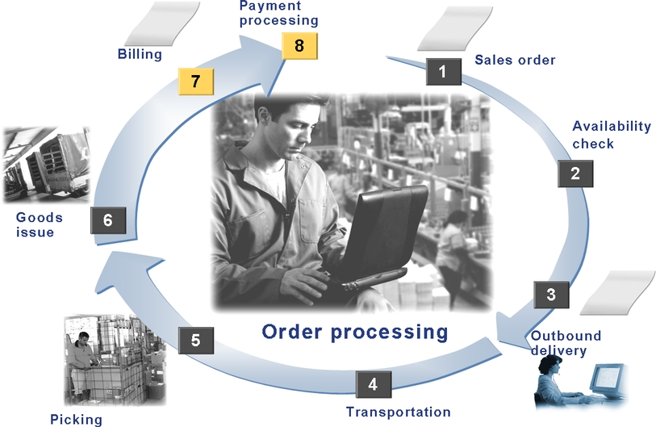
Sales Order Process Overview
Notes:
self-service requisitioning = untuk barang2 kecil (ATK, RAM rusak)

Slide 6
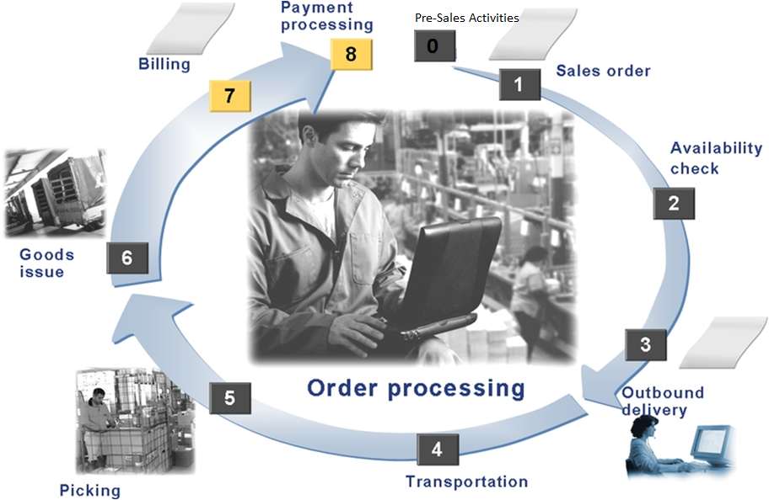

Pre-Sales Activities
Promotion activities
Inquiries
Quotation

Slide 7

Sales Order (SO)
Adopt information from pre-sales activities.
Sales Order(SO)
Sales scheduling agreement or sales contract are created with reference to a SO

Slide 8
Sales Order
During SO creation, system carry out basic function:
Monitoring Sales transaction
Checking for availability
Transferring requirement to MRP
Scheduling delivery
Calculating pricing and taxes
Checking credit limit (per year limit)
Creating printed or electronically transmitted document

Slide 9
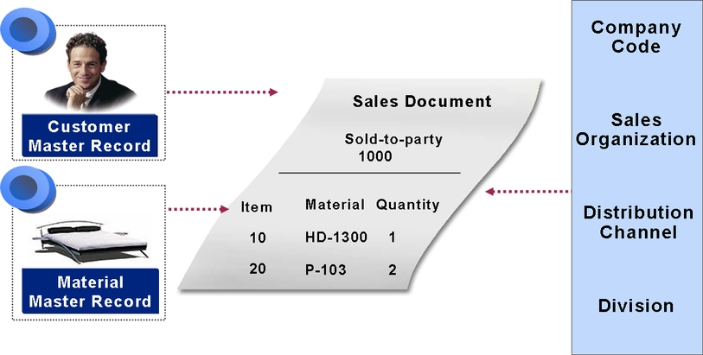
Sales Order
Basic function can be automated or manual processing.
Data result form basic function is stored in sales document.

Slide 10

Availability Check
Availability material can be checked to confirm the customer’s requested delivery date.

Slide 11

Outbound delivery
Shipping
is an important part of logistics chain
 Outbound Delivery
(Surat Jalan)

Slide 12
Delivery
In shipping processing, delivery procedure can be made:
General business agreement
Recording special material request
Define shipping condition

Slide 13
Delivery
Shipping module function:
Deadline monitoring for reference document due for shipment
Creating and processing outbound deliveries
Packing deliveries
Information support for transportation planning
Supporting foreign trade requirement
Printing and transmitting shipping document
Processing goods issue
Deliveries currently in process
Activities that are still to be carried out
Identifying possible bottlenecks

Slide 14
Delivery
Document to support delivery process  Outbound Delivery(Surat Jalan)
shipping activities (picking, packing, transportation and good issue)

Slide 15
Delivery
How to create outbound delivery document?
With reference to SO doc
With reference to stock transport order
With reference to subcontract order
With reference to a project
Without any reference

Slide 16

Transportation
Setting:
Transportation media
Route
Checking point
Picking Point

Slide 17
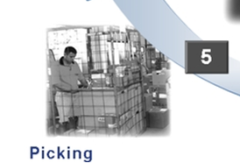
Picking/Packing/Shipping
 Transfer Order
(Document from sales to warehouse)

Slide 18
Picking
Ways to do picking
Automatically (During OD Creation)
Routinely (at certain time)
Manually (via employee request)
Notes:
Setiap picking status di rekam untuk proses scheduling dan monitoring.
Delivery qty = picking qty = outbound qty

Slide 19

Goods Issue
Basis of Goods Issue posting is Outbound delivery
Any changes in Good issue posting should be made in Outbound delivery

Slide 20
Good Issue
Posting Good Issue for OD function include:
Warehouse stock of material is reduced by delivery quantity
Value change are posted to balance sheet account in inventory accounting
Requirement are reduced by the delivery quantity
The serial number status is updated
Good issue is posting automatically recorded in the document flow
Stock determination is executed for the vendor ‘s consignment stock
A work list for the proof of delivery is generated

Slide 21
Good Issue
Ways to post GI
Automatically (During OD Creation)
Routinely (at certain time)
Manually (via employee request)

Slide 22

Billing
Final stage in SO processing

Slide 23
Billing
Billing function include
Creation of invoices based on deliveries/service
Issue of credit and debit memo and pro forma invoice
Canceling billing transaction
Comprehensive pricing function
Issue rebate
Transfer billing data to financial accounting
Notes:
A credit note or credit memorandum (memo) is a commercial document issued by a seller to a buyer. The seller usually issues a Credit Memo for the same or lower amount than the invoice, and then repays the money to the buyer or sets it off against a balance due from other transactions.

Slide 24
Billing
How to create billing document?
With reference to SO doc
With reference to a delivery doc
With reference to external transaction

Slide 25
Billing
How to create billing document? Cont
Automatically for billing due list as background task
Manually for work list
Explicitly creating billing document
Collective billing document from several SO
Invoice split
…

Slide 26
Billing
How to create billing document? Cont
Automatically for billing due list as background task
Manually for work list
Explicitly creating billing document

Slide 27
Billing and Financial Accounting
Account affected
Customer A/R
GL (eg. Cash clearing account)
Revenue
Sales deduction
Accruals (for rebate agreement)
Accrual account
Accrual clearing account

Slide 28
Billing
Create
Change
Delete Billing document
Notes:
Rebate = discount

Slide 29
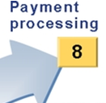
Payment Processing

Slide 30
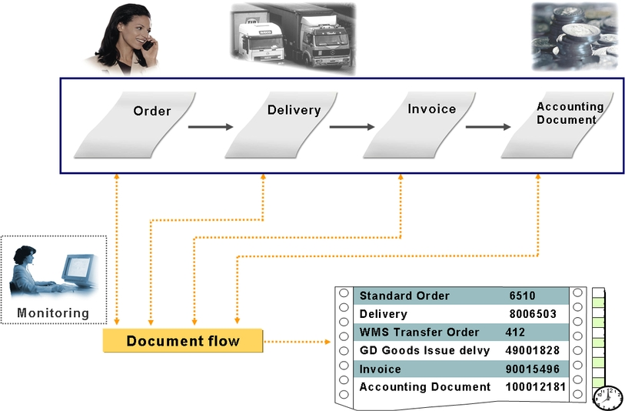

Slide 31
Sales Order Mgmnt Process Summary
0. Pre Sales Activity
Doc: Inquiry, Quotation
Exercise 5-3
Exercise 4-6
Doc: Sales Order
Exercise 4-4
Doc: Good Issue Doc
Exercise 4-5 no.2
Doc: Transfer Order
Doc: Delivery Order
Exercise 4-5 no.1
Notes:
self-service requisitioning = untuk barang2 kecil (ATK, RAM rusak)

Slide 32

End of This Session

